Slide 1
Team – F Pecunia Banking System Members Aditya Akshay Aishwarya Ayush Samanway

Slide 2
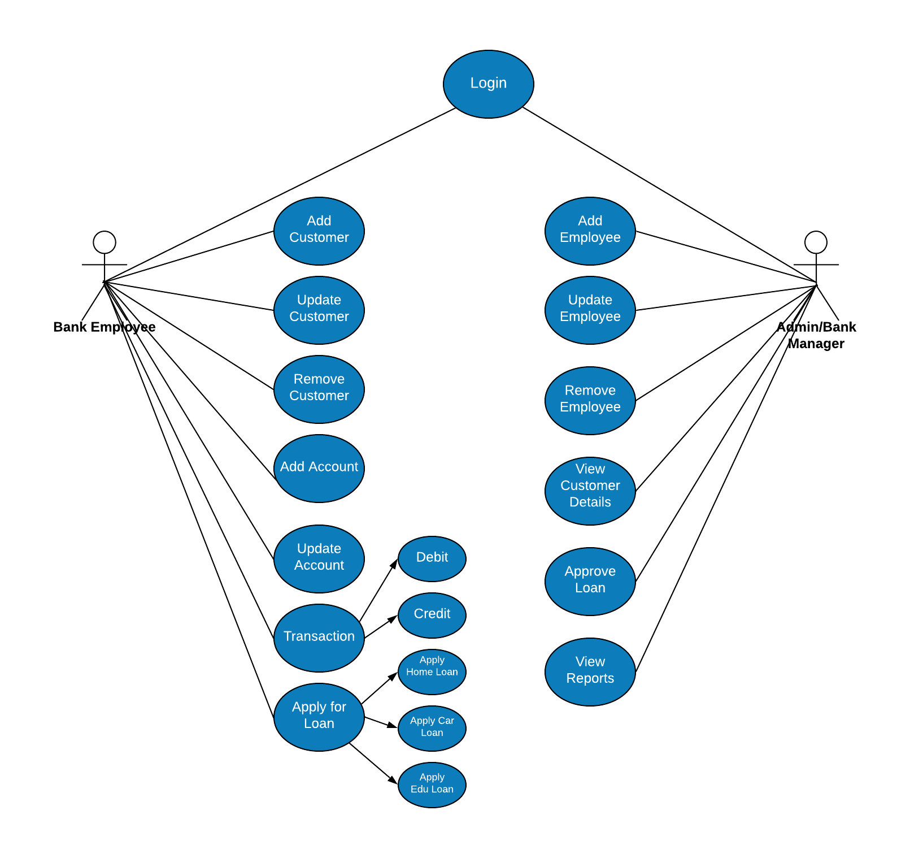
USE CASE DIAGRAM

Slide 3
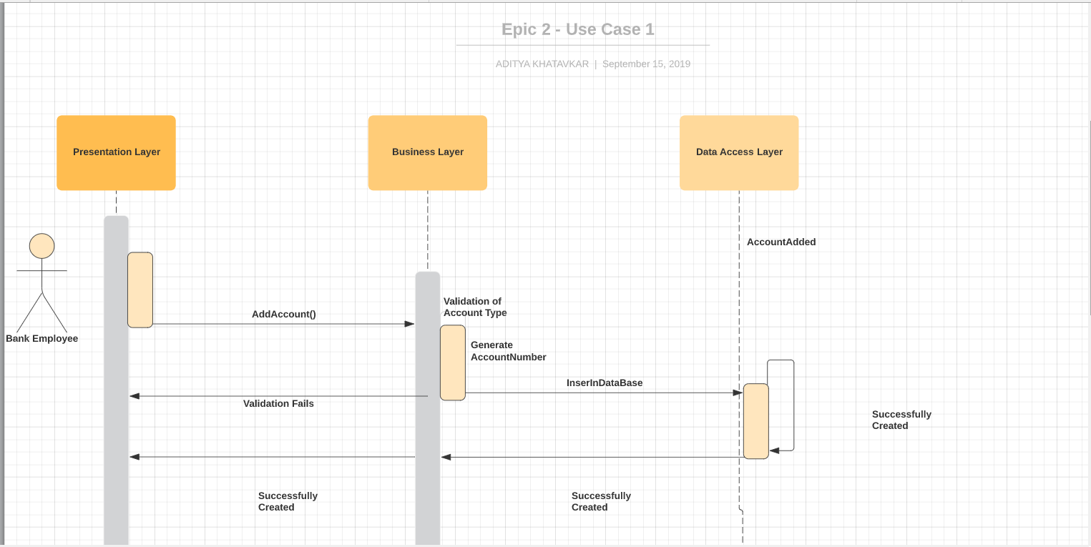
Use Case Bank Employee Adding account and generating account Number.

Slide 4
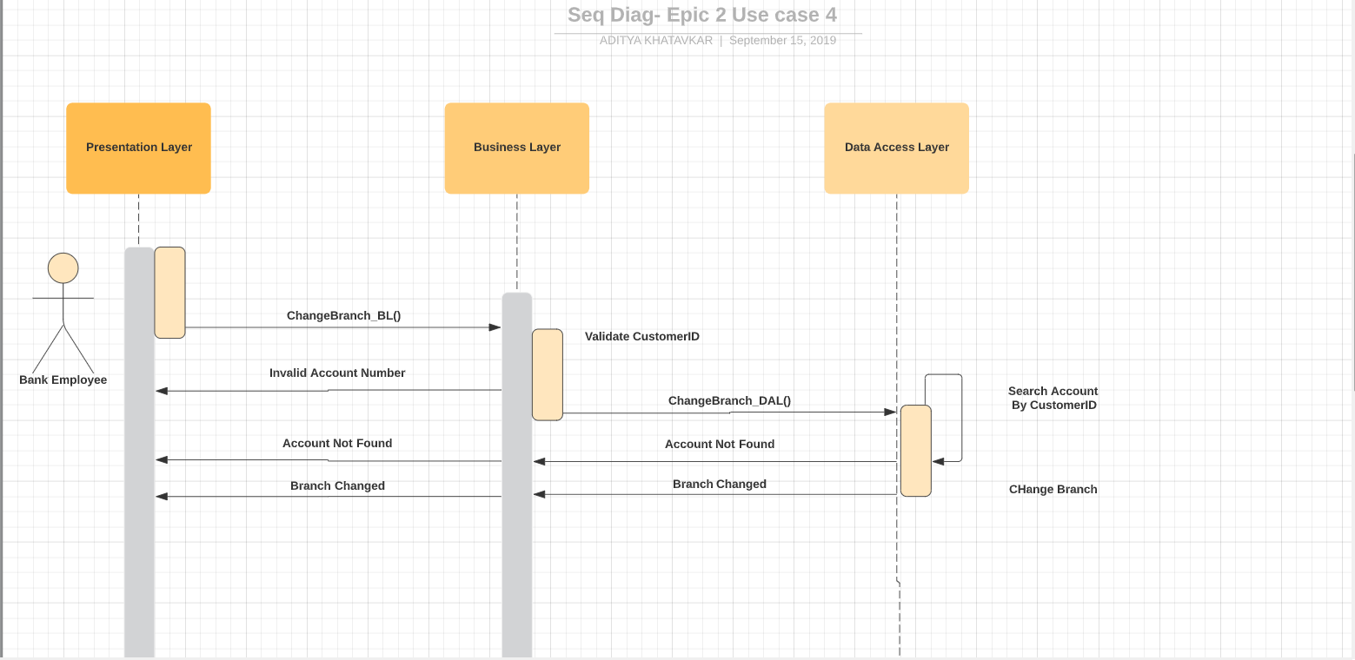
Use Case Bank Employee changing Home branch of customer based on CustomerID.

Slide 5

Use case Bank Employee Deleting Account and

Slide 6
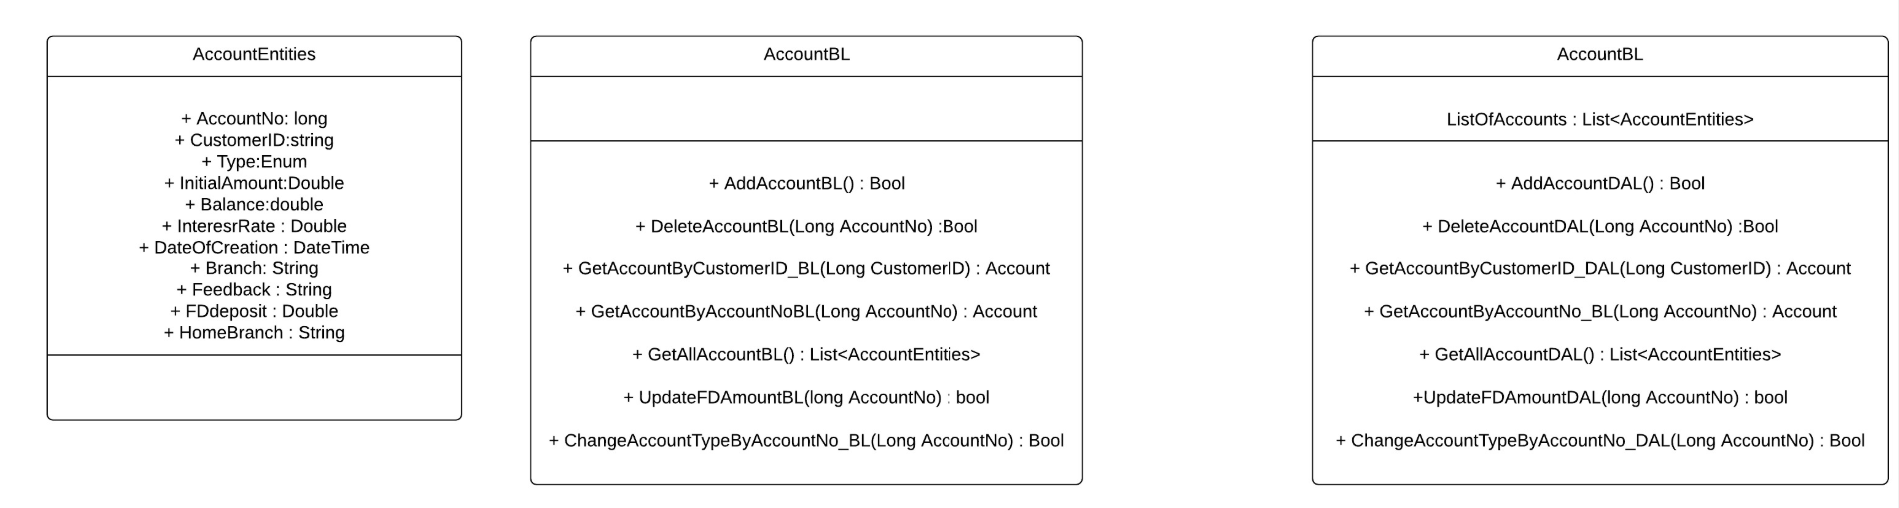
Class Diagram

